Slide 1
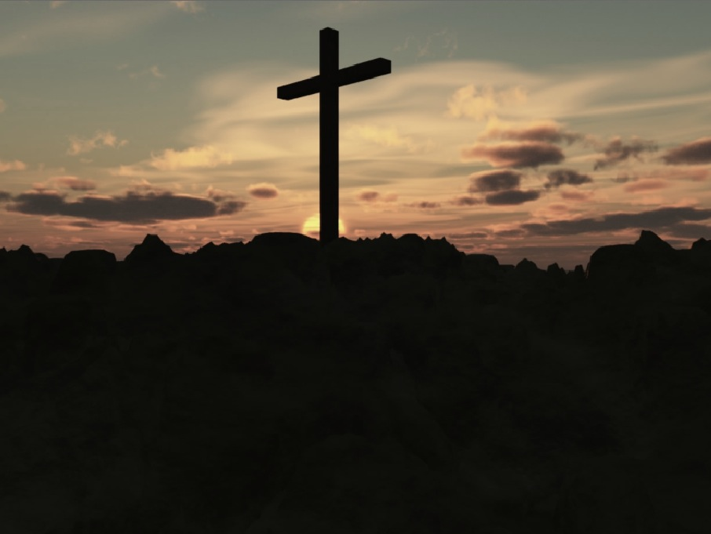
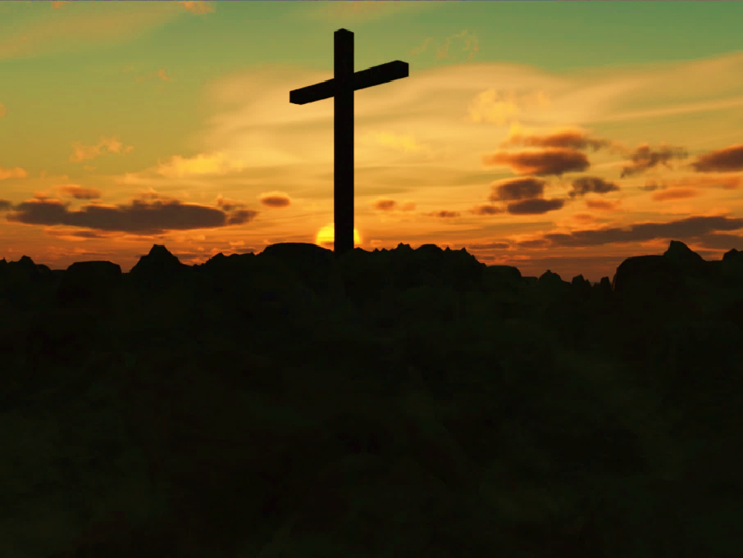
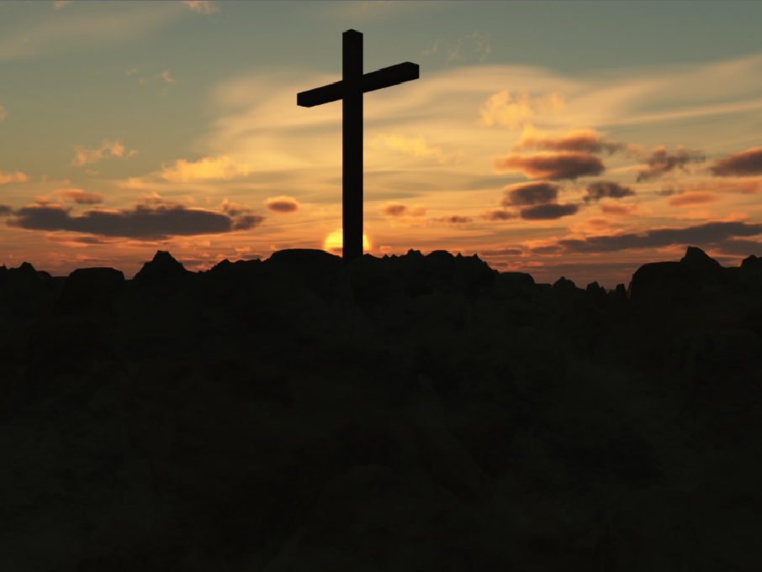

Who is responsible for printing the program?
The church is responsible for printing the funeral program for services on-site. For funeral or memorial services off-site, the family is responsible for printing the program. The funeral home can assist you in printing your program or recommending a quality printing company.
It is our prayer that we can be a blessing to
you and your family. Therefore, we have
provided the following map to aid you,
your extended family, and friends in locating parking around First United Methodist Church. If you have any questions, please contact the church at: (248) 474-6573.
For Your Convenience
Funeral Planning
Guide
“There is a time for everything, and a
season for every activity under heaven...”
Ecclesiastes 3:1 NIV
School St.
Hillside
Townhome
Development
Grand River
Thomas St.
Historic
District
Parking
#1
First
United
Methodist
FIRST UNITED METHODIST CHURCH
33112 Grand River Ave.
Farmington, MI 48335
Phone: (248) 474-6573
www.farmingtonfumc.org
Rev. Dr. Anthony R. Hood
Pastor
Warner St.
Historic
District
Parking
#2
Los Tres
Amigos
Updated 3-13-2025 ARH

Slide 2
Who do I call to make funeral or memorial service arrangements?
Call the church office and speak to the Church Administrator, Phyllis Anderson. Phyllis will contact the pastor and check the church calendar for availability. The pastor, and appropriate additional staff, will meet with your family to finalize the arrangements for your loved one's service.
Who can have their funeral or memorial service at First United Methodist Church?
We are a community of faith, here to serve the needs of our membership and our community. Members and their immediate families take priority when scheduling funeral services. However, the community at large are welcome to have their funeral or memorial services at First United Methodist Church. First United Methodist Church is an alcohol and tobacco free facility. Smoking and the consumption of alcohol within the facilities is strictly prohibited.
Is there a fee for having a funeral at the church?
Funerals and Memorial services for members and their immediate family are free of charge. However, the family is responsible for the organist’s fee.
Non-Members will be accessed the following fees for holding their funeral or memorial service:
Organist Fee $200.00
Building Usage Fee *$100.00
Custodial Fee *$75.00
*Fees are due 48hours prior to the date of the funeral/memorial service.
The Church does not accept personal checks for payment. We accept cash, certified checks and money orders for payment. You may use a personal check for payment of the Organist.
Does the church recommend a funeral home?
No, the church does not have a preferred or recommended funeral home. The following is
a list of reputable funeral homes:
Heeney-Sundquist Funeral Home
(248) 474-5200
Thayer-Rock Funeral Home
(248) 474-4131
Will the church provide an organist?
The church will secure the services of an organist. However, the family is responsible for paying the organist fee of $200 directly to the organist
Can we have a luncheon for our family and friends? Is there a fee?
The church will prepare a luncheon, upon request, for your family and friends in Wesley Hall. The fees are: $10 per person for a full luncheon and $5 per person for light desserts and drinks.
You may also choose to have an outside caterer to provide a luncheon in Wesley Hall. Caterers must be licensed, bonded and insured; taking full legal liability for all food prepared and served during the luncheon.
Can someone other than the pastor give the eulogy or officiate the service?
The pastor, as shepherd and leader of First United Methodist Church, is responsible for officiating and giving the eulogy for all funeral services. However, special consideration will be given on a case-by-case basis.
You are free to include outside clergy in the funeral service offering prayer, a musical selection, or reading scripture.
A Word of Comfort
The first few moments after the loss of a loved one are tough. The finality of death catches many of us unaware and sometimes unprepared. It is our prayer that this guide will help empower you and your family in preparing the funeral arrangements for your loved one.
We have designed this Funeral Preparation Guide to answer many of the basic questions families have when planning a funeral service for their loved ones. Within this guide you will find information about the services Scott Memorial UMC provides for funerals, along with the contact numbers for several reputable funeral homes and printing companies.
I leave you with these words recorded in the book of Romans 8:35, 37-39:
“Who shall separate us from the love of Christ? Shall trouble or hardship or persecution or famine or nakedness or danger or sword?......No, in all these things we are more than conquerors through him who loved us. For I am convinced that neither death nor life, neither angels nor demons, neither the present nor the future, nor any power, neither height nor depth, nor anything else in all creation, will be able to separate us from the love of God that is in Christ Jesus our Lord.”
Peace be upon you,
Rev. Dr. Anthony R. Hood
Pastor
Updated 3-13-2025 ARH

